Slide 1

Tableau Project Zomato
Yatin Bajaj – 19csu360
Shruti Gupta – 19csu424

Slide 2
Project Description
Bengaluru is best place for foodies. The number of restaurant are increasing day by day. Currently which stands at approximately 12,000 restaurants. With such an high number of restaurants. This industry hasn't been saturated yet. And new restaurants are opening every day. However, it has become difficult for them to compete with already established restaurants. The key issues that continue to pose a challenge to them include high real estate costs, rising food costs, shortage of quality manpower, fragmented supply chain and over-licensing. This Zomato data aims at analyzing demography of the location. Most importantly it will help new restaurants in deciding their theme, menus, cuisine, cost etc for a particular location. It also aims at finding similarity between neighborhoods of Bengaluru on the basis of food. The dataset also contains reviews for each of the restaurant which will help in finding overall rating for the place.

Slide 3
Dataset Description
The basic idea of analyzing the Zomato dataset is to get a fair idea about the factors affecting the establishment of different types of restaurant at different places in Bengaluru, aggregate rating of each restaurant, Bengaluru being one such city has more than 12,000 restaurants with restaurants serving dishes from all over the world. With each day new restaurants opening the industry hasn't been saturated yet and the demand is increasing day by day. Despite increasing demand, it however has become difficult for new restaurants to compete with established restaurants. Most of them serving the same food. Bengaluru being an IT capital of India. Most of the people here are dependent mainly on the restaurant food as they don’t have time to cook for themselves. With such an overwhelming demand of restaurants it has therefore become important to study the demography of a location. What kind of a food is more popular in a locality. Do the entire locality loves vegetarian food. If yes, then is that locality populated by a particular sect of people for e.g. Jain, Marwaris, Gujaratis who are mostly vegetarian.

Slide 4
Analysis
Factors to consider while opening a new restaurant
Does the demography of an area matters?
Does location of a particular type of restaurant also depends on the people living in that area?
Does the theme of the restaurant matter?
Are any neighborhood similar ?
If two neighborhood are similar does that mean these are related or particular group of people live in the neighborhood, or these are the places to it?
What kind of a food is more popular in a locality.
Do the entire locality loves vegetarian food.

Slide 5
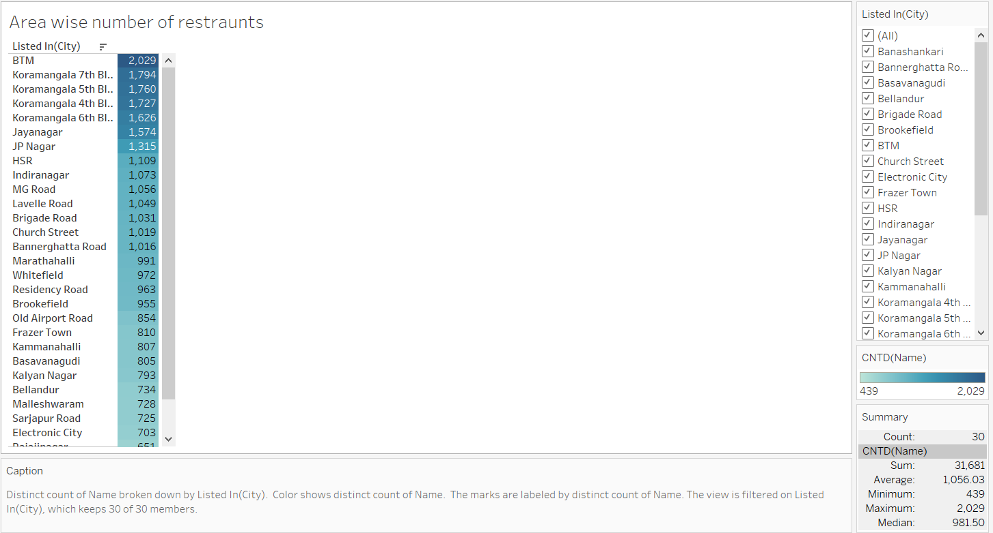
Area wise number of restaurants

Slide 6
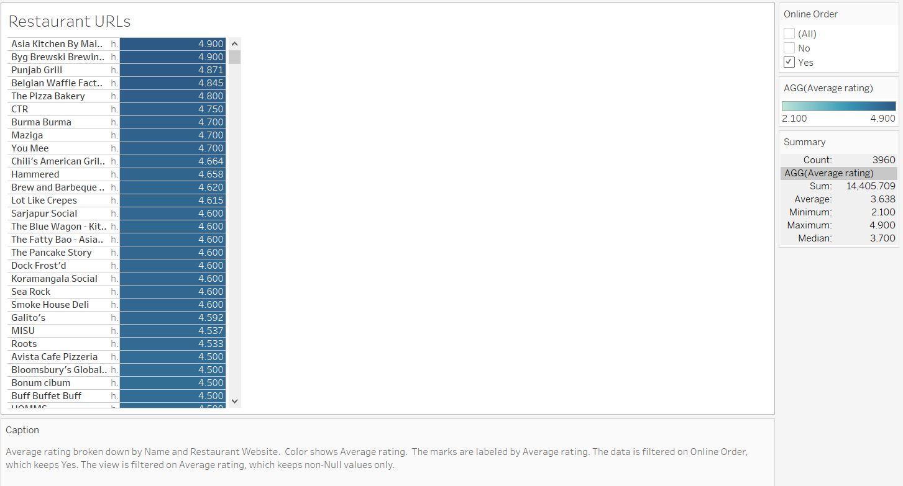
Restaurant URLs

Slide 7
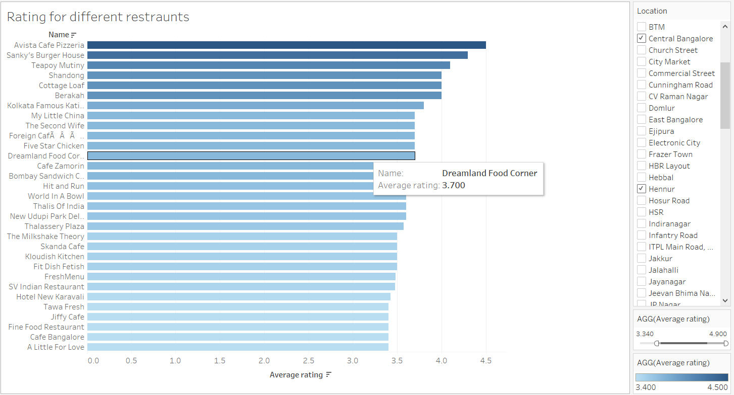
Rating for different restaurants

Slide 8
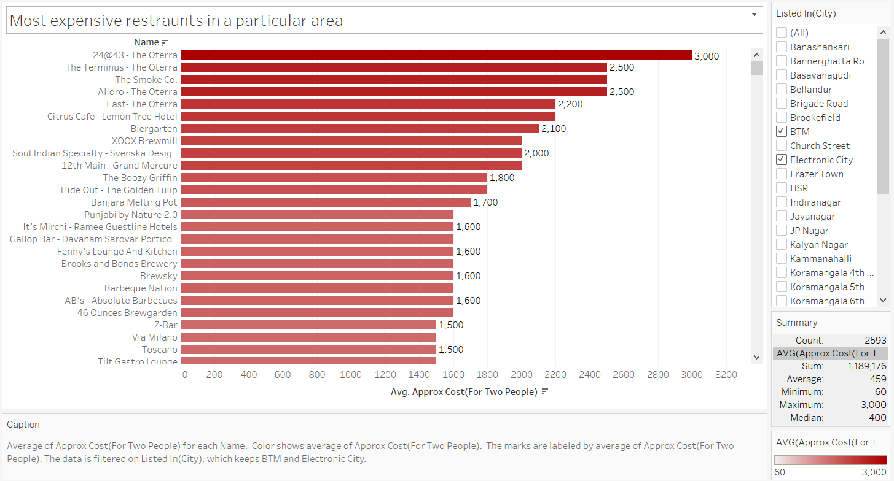
Most expensive restaurants in a particular area

Slide 9
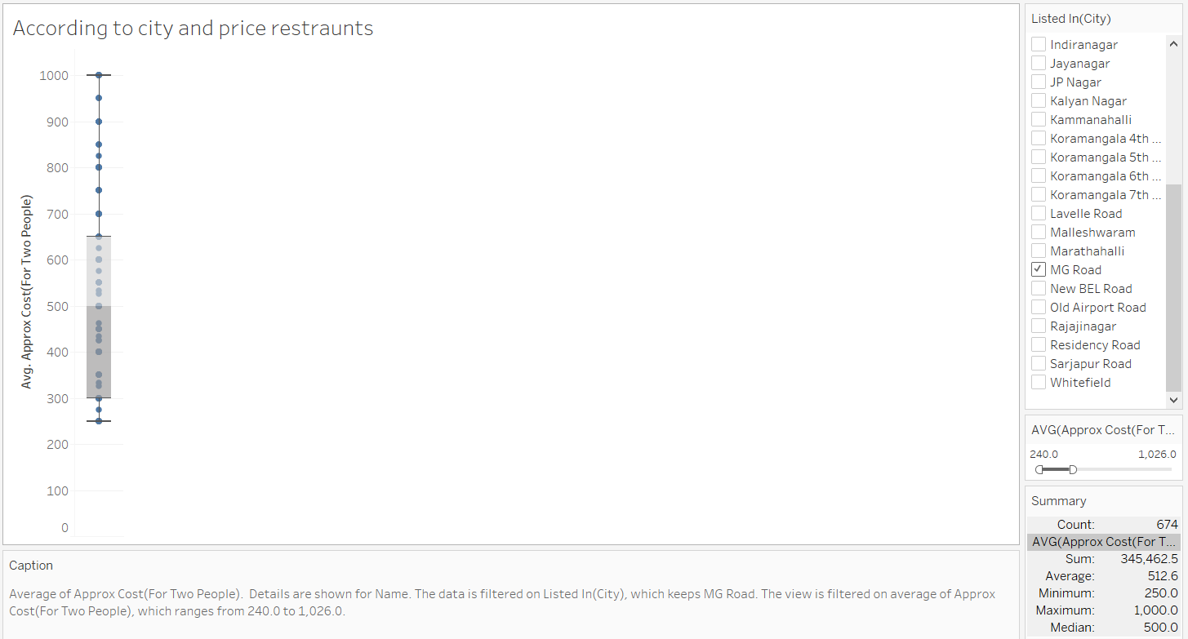
According to city and price restaurants

Slide 10
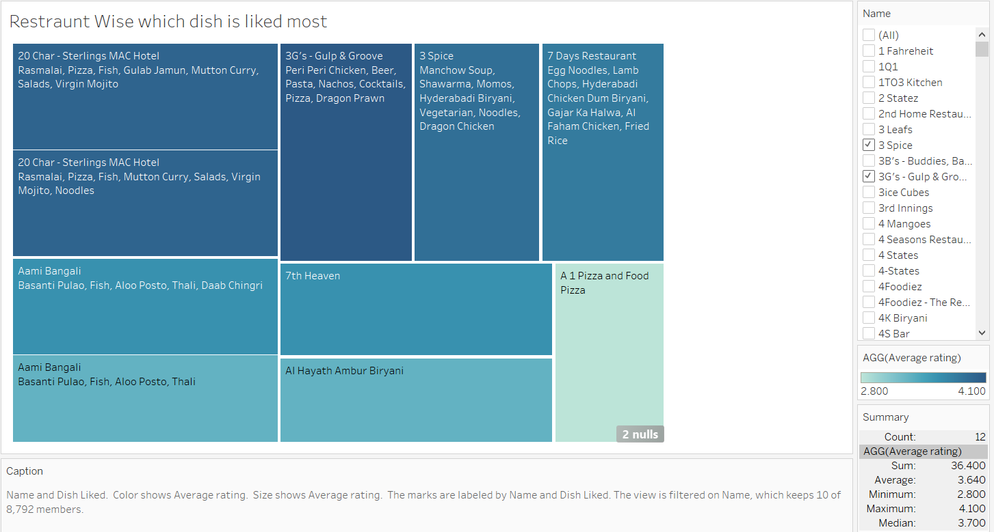
Restaurant Wise which dish is liked most

Slide 11
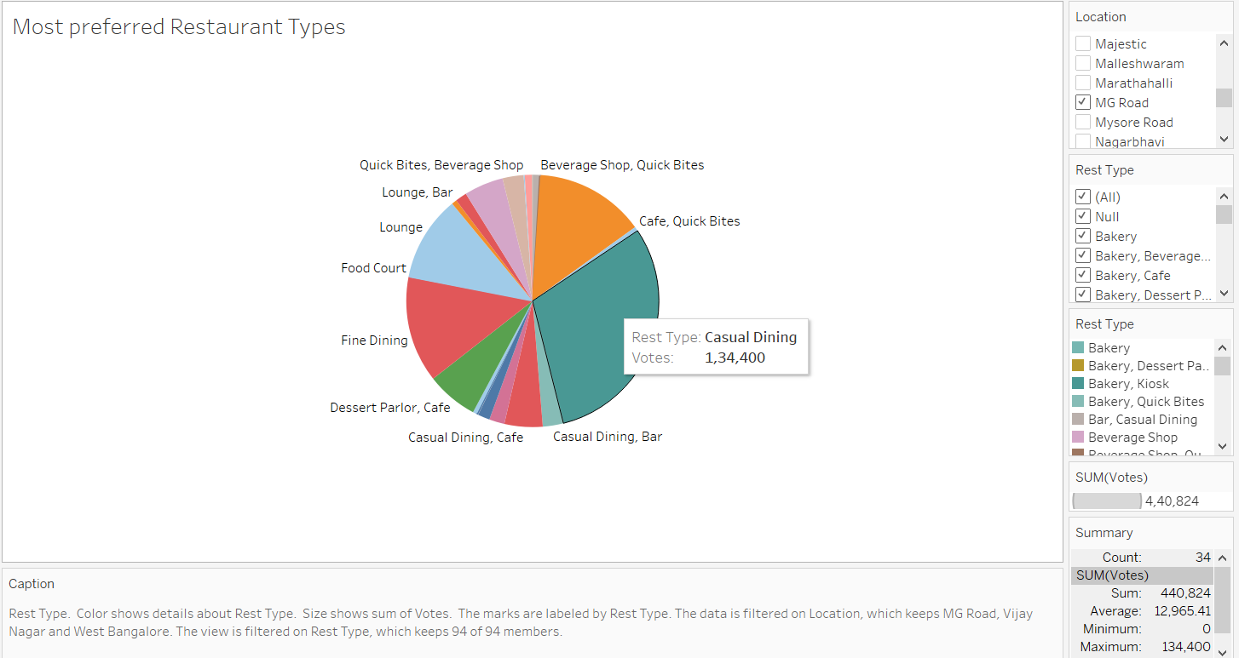
Most preferred Restaurant Types

Slide 12
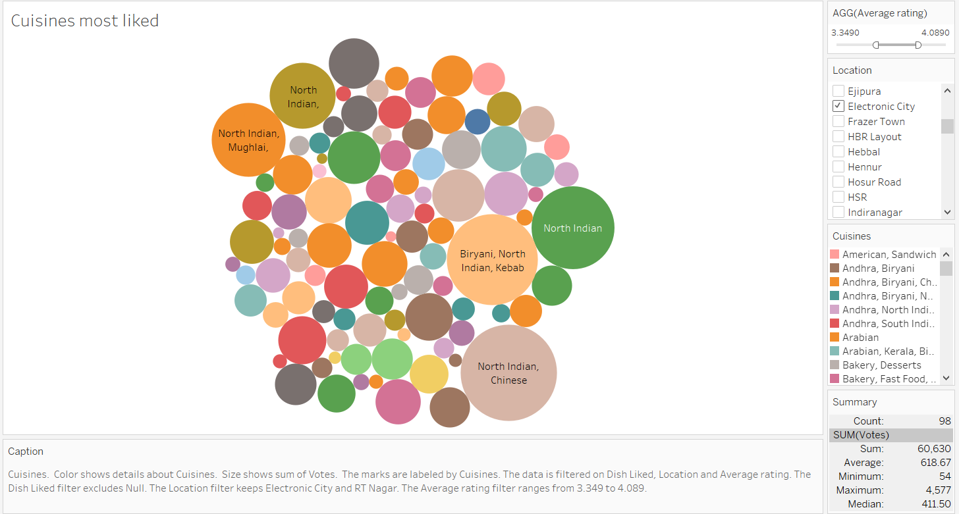
Cuisines most liked

Slide 13
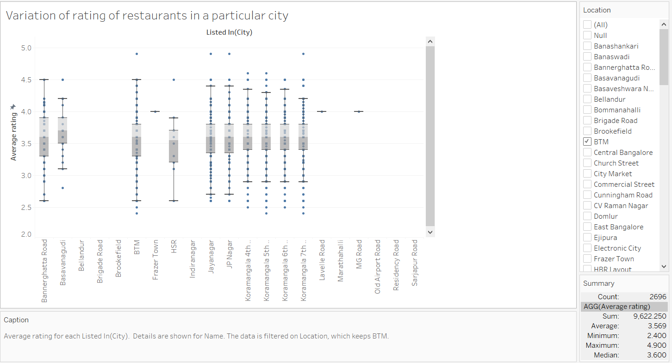
Variation of rating of restaurants in a particular city

Slide 14
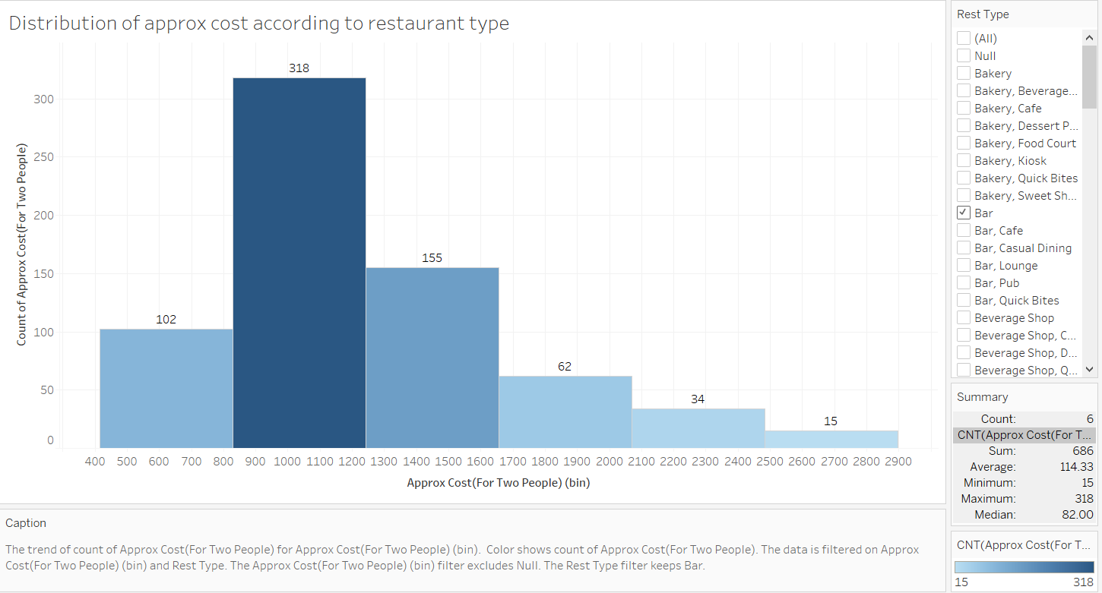
Distribution of approx. cost according to restaurant type

Slide 15
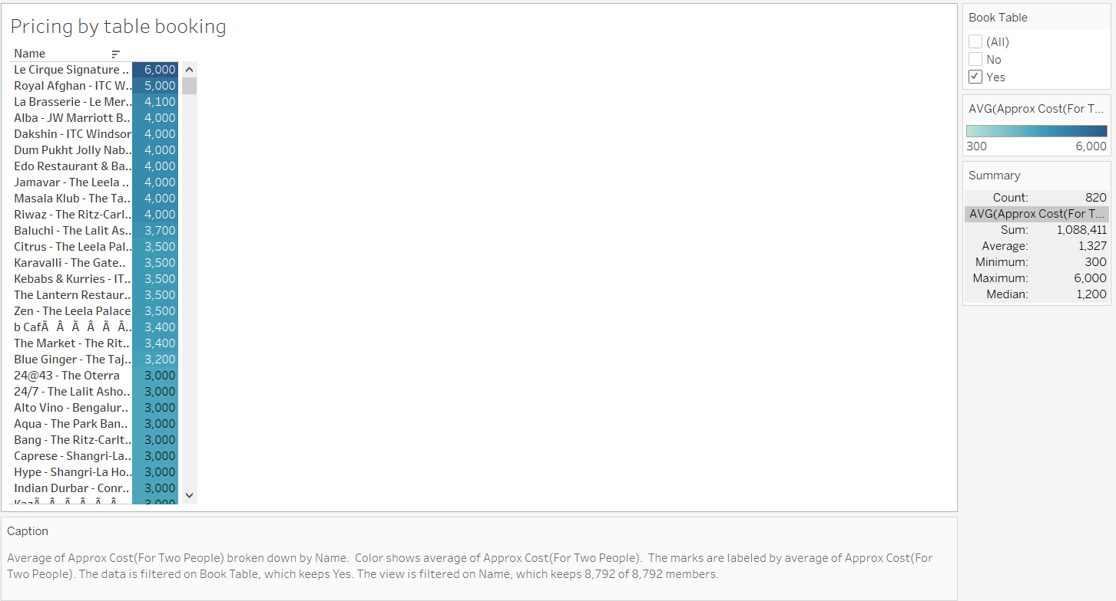
Pricing by table booking

Slide 16
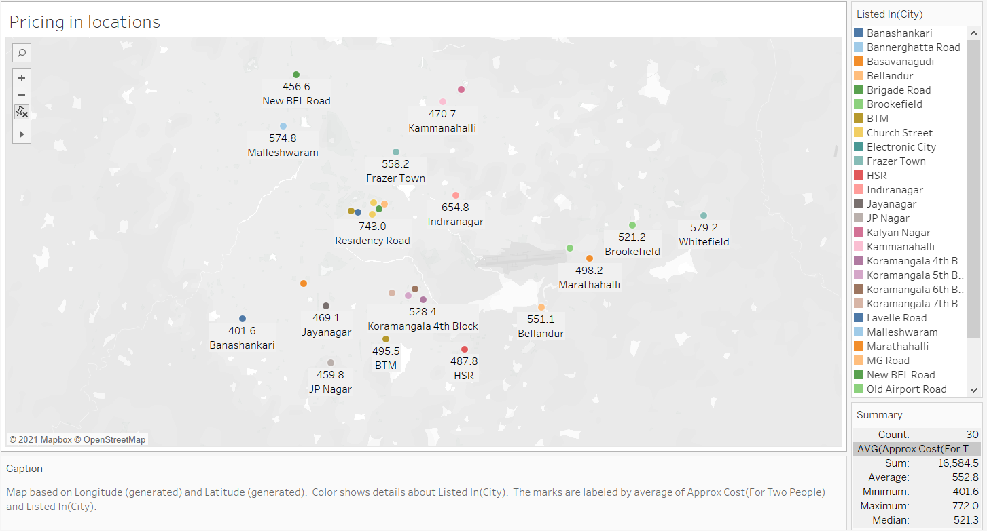
Pricing in locations

